Slide 1
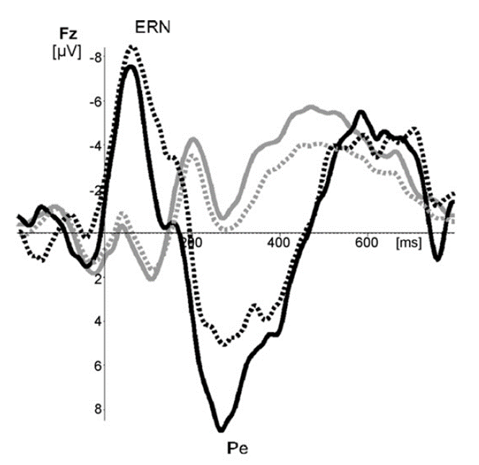
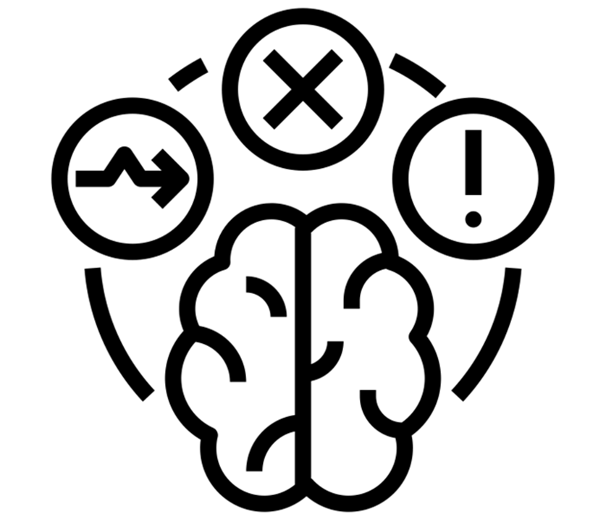
Miranda C. Lutz, MSc. Ph.D. Candidate Erasmus University Rotterdam, The Netherlands
The addicted brains’ ability to react to errors is reduced
Are error-related negativity
(ERN) and error positivity
(Pe) reduced in adults with
addiction problems and
disorders when compared
to healthy controls?
Error-related Negativity (ERN)
Error Positivity (Pe)
PubMed, PsychInfo, Scopus
Flanker & Go NoGo task
Addiction & healthy control sample
EEG electrode FCz for ERN, Cz for Pe
Random Effects Meta-Analysis:
ERN (K= 13 studies; 734 subjects)
Hedges’s g = 0.49, 95% CI .22, .76
Pe (K=12 studies, 714 subjects)
Hedges’s g = -0.06, 95% CI -.27, .16
No significant moderators
No publication Bias
Conclusion:
The ability of the brain to respond to errors is diminished. Reduced error monitoring implies abnormal activation by the dorsal-anterior cingulate cortex and problems adjusting performance monitoring and behavior in individuals with addiction disorders or problems.
Authors: Miranda C. Lutz, Rianne Kok, Ilse Verveer, Marcelo Malbec, Susanne Koot, Pol A. C. van Lier, Ingmar H. A. Franken
ERN =Error- Related Negativity
Pe = Error Positivity
taken with permission from
Franken et al., 2010
Notes:
When trying to understand complex behavior like addiction behavior, we turn to study the brain’s activity during tasks that mimic similar behavior. For instance, being unable to respond to an error during performance monitoring has been repeatedly observed in patients with substance use addiction disorder or problems.
However, a systematic analysis of these error processing deficits measured through event-related potentials was not yet performed. Event-related potentials are brain responses measured through an electroencephalogram (or EEG).
Therefore, we conducted a meta-analysis to compile studies that measure two brain reactions after error making, called the Error-related negativity or ERN and Error positivity (Pe).
We calculated effect sizes from EEG studies that observed the ERN at the frontal-central electrode and Pe at the central electrode through cognitive tasks like the go-nogo and flanker task by comparing individuals with SUD disorder or problems with healthy controls.
A random-effect meta-analysis of ERN, containing 13 studies with 734 subjects, resulted in a Hedges’g effect size of .46, from which we can conclude that the ERN amplitude is significantly reduced in patients with SU disorder or problems when compared to healthy controls. This was not the case for Pe. Also, the use of task, presence of comorbidity, and type of addiction did not explain the observed heterogeneity of effect sizes for both action potentials.
We can conclude that the diminished reaction of the brain towards an error suggests an abnormal activation pattern during monitoring of behavior, which is in line with the problematic behavior we see in patients with substance use problems. We recommend studying error monitoring in behavioral addiction and the feasibility of modulating brain activation to improve error-monitoring deficits.

